Slide 1
Strongly Connected Components

Slide 2
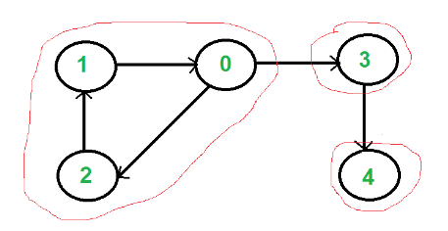
A directed graph is strongly connected if there is a path between all pairs of vertices.
Strongly Connected Components
0
1
2
4
A strongly connected component (SCC) of a directed graph is a maximal strongly connected subgraph.
1-0-2
3
4

Slide 3
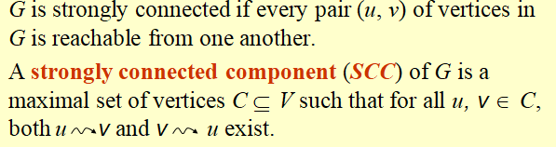
Strongly Connected Components

Slide 4
Kosaraju’s Algorithm to determine SCCs
SCC(G)
call DFS(G) to compute finishing times f [u] for all u
compute G^{T}
call DFS(G^{T}), but in the main loop, consider vertices in order of decreasing f [u] (as computed in first DFS)
output the vertices in each tree of the depth-first forest formed in second DFS as a separate SCC
Time: Θ(V + E).
0
1
0
1
G
G^{T}
2
4
2
4

Slide 5
Kosaraju’s Algorithm to determine SCCs
1) Create an empty stack ‘S’
2) Do DFS traversal of a graph. In DFS traversal, after calling recursive DFS for adjacent vertices of a vertex, push the vertex to stack.
3) Reverse directions of all arcs to obtain the transpose graph.
4) One by one pop a unvisited vertex from S while S is not empty. Let the popped vertex be ‘v’. Take v as source and do DFS call on v. The DFS starting from v prints strongly connected component of v.

Slide 6
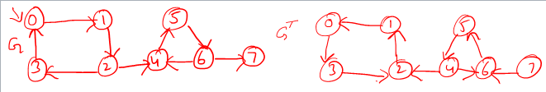

Slide 8
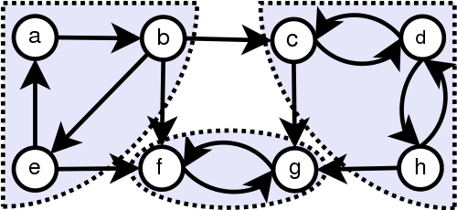
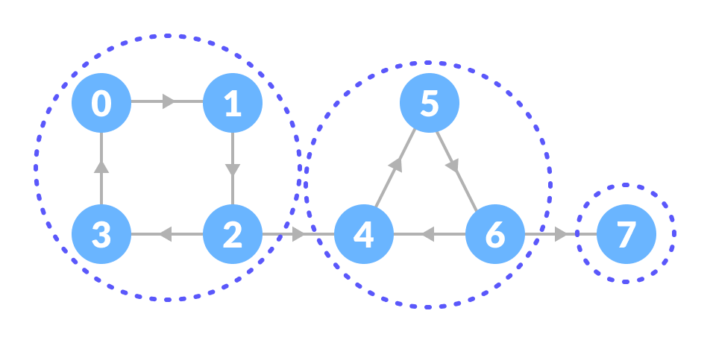
Example

